Slide 1

Project system
Coffee maker
Jan Bollen

Slide 2

Agenda
Projects
Methodological design
Stakeholders
V model
Project Setup
System Requirements
Functional Design
Technical Design
Testing
Deliverables

Slide 3

Project goals
MAJOR educational goals:
60% project management
V model / Project plan / meetings / logbook / report / poster / presentation / demonstration
MINOR educational goals:
40% technical
Temperature measurement and control / sensor / signal processing / controller / power stage / load

Slide 4

Assignment
Saxion LED is looking
for an engineering company who can
modify a simple coffeemaker machine
into an advanced coffeemaker machine.
The temperature of the drinking coffee should be adjustable by the user.
LED want to have a ready made working demonstration model inclusive all documentation.
The company will be rewarded with 7 credit points.

Slide 5

YOUR Company
  The company should have 4 members:
  1 chairman, 1 secretary, 2 designers
  Every company should have a
  name and a logo
  For international students:
  It is not allowed to have the same nationality in the same company … ;(

Slide 6
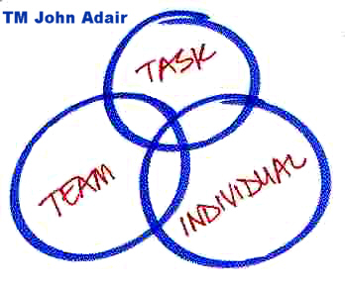
Teamwork
Every member of the company
should have an individual task.
Chairman / Secretary / Planner / Documentalist
Key point of good teamwork is:
Planning (task)
Communication (meetings) and
Co-operation (product)

Slide 7
Time table
Q3
Lectures explanation of theory and work method
Project work Company work with small guidance
Homework Individual tasks
Q4
Project work Company work with small guidance
Homework Individual tasks

Slide 8
Deliverables
  Projectplan
  Agenda / Minutes
  Powerpoint functional design
  Report
  Poster
  Final powerpoint

